Slide 1
Algorithm
Dr/ Wael Zakaria

Slide 2
Team
Mohamed Amr 20106990
Karim Alaa 20104286
Ziad Hazem 19106626
Osama Khalid 20106445

Slide 3

Agenda
Description
Finding all subsets
Enter n of elements & storing inputs into array(elements )
Removing dublicates
Calling and printing subsets
Requirements
Execution

Slide 4

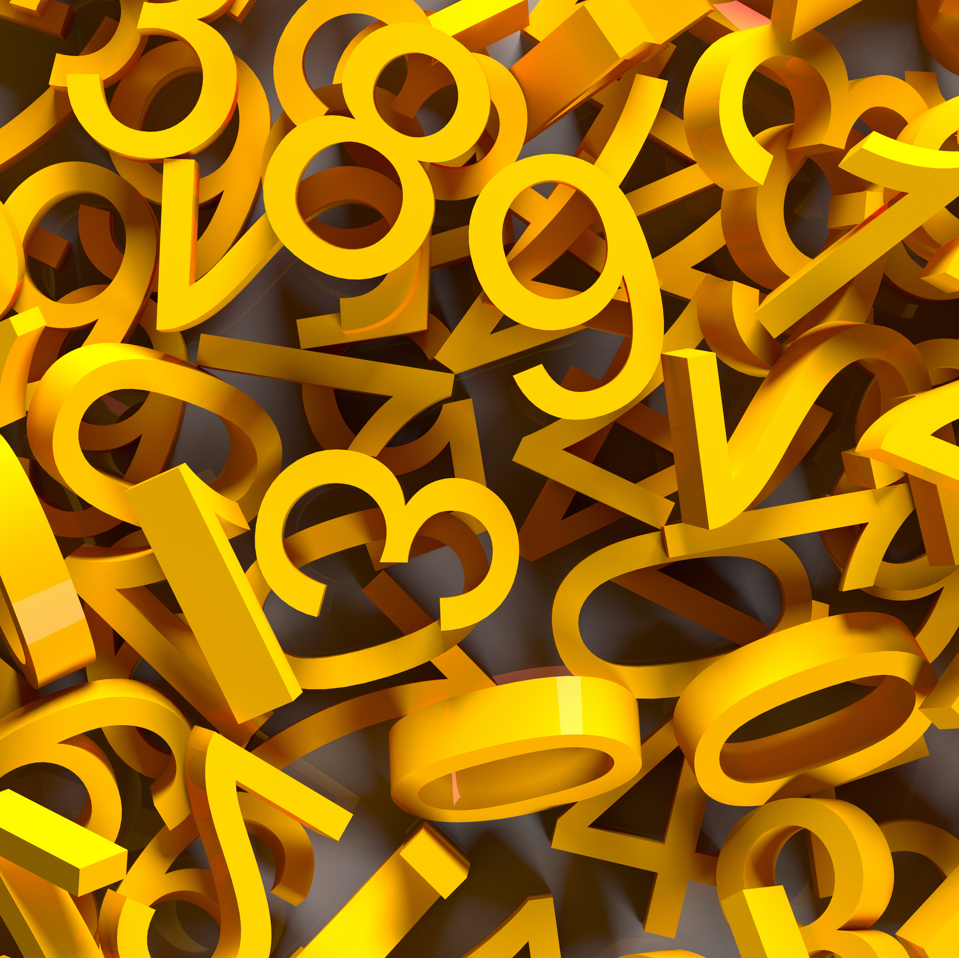
description
Finding subsets involves generating all possible subsets of a given set. A subset is a collection of elements taken from the original set, where the order of the elements doesn't matter. For example, given the set {1, 2, 3}, some of its subsets would be {}, {1}, {2}, {1,2}, {3}, {1, 3}, {2, 3} , {1,2,3}

Slide 5

Finding all subsets

Slide 6

for i <- 0 in unique_elements do
for j<- 0 in subsets do
new_subset <- j + [i]
new_subsets.append(new_subset)
subsets.extend(new_subsets)
return subsets

Slide 7
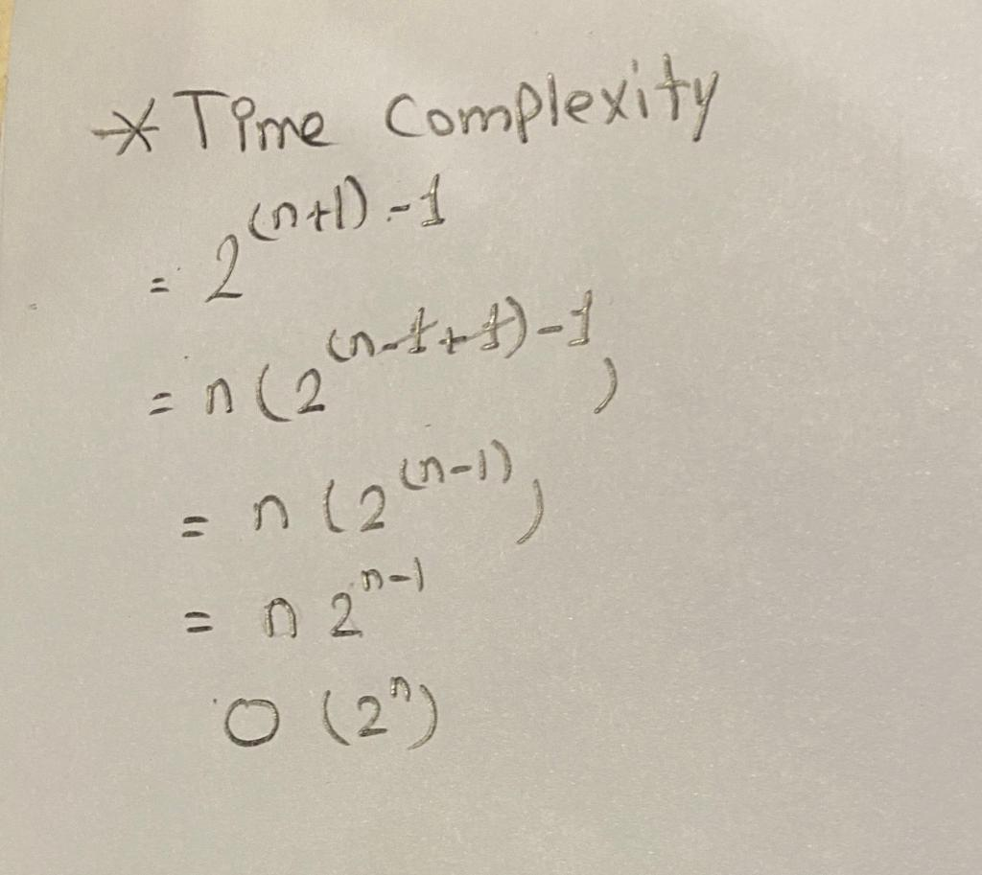
Calculating Time Complexity of finding all subsets

Slide 8

DEF FindAllSubsets (unique_elements):
SUBSETS = [[]]
FOR I IN unique_elements:
NEW_SUBSETS = []
FOR J IN SUBSETS:
NEW_SUBSET = J + [I]
NEW_SUBSETS.APPEND(NEW_SUBSET)
SUBSETS.EXTEND(NEW_SUBSETS)
RETURN SUBSETS

Slide 9

Enter n of elements & storing inputs into array(elements )

Slide 10

for i <- 0 to n do
num = int(input())
elements.append(num)

Slide 11
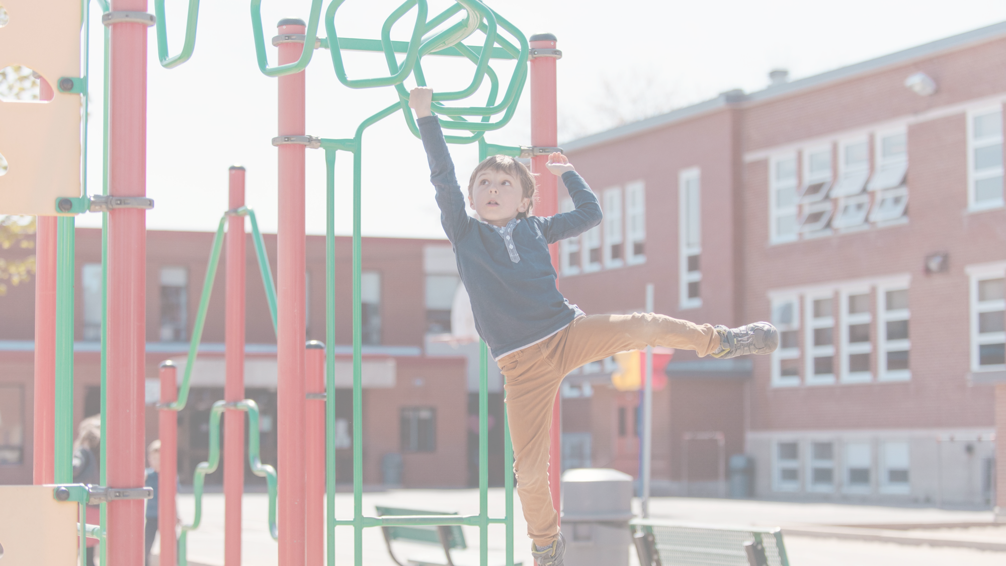
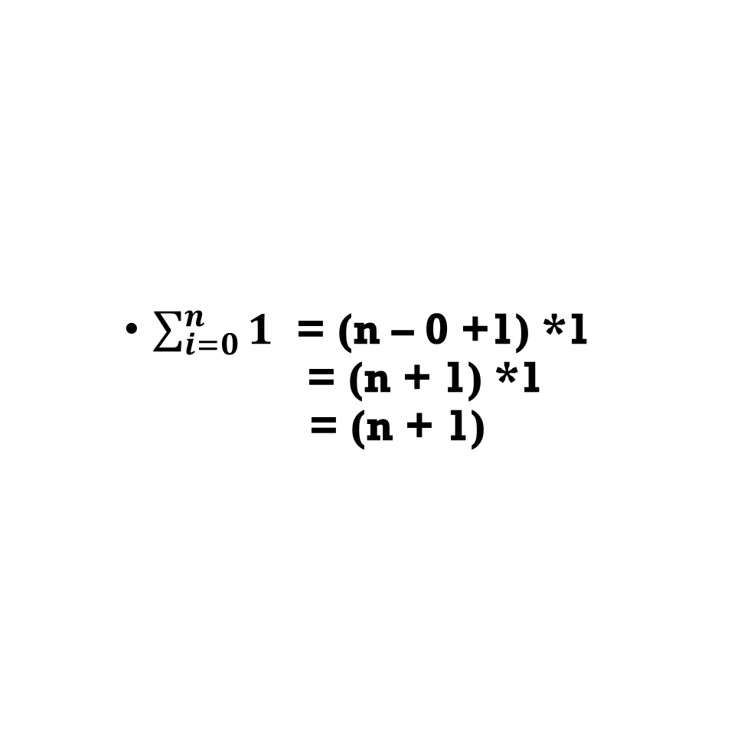
$\sum_{i=0}^{n}{1}$ = (n – 0 +1) *1 = (n + 1) *1 = (n + 1)

Slide 12
Removing duplicates

Slide 13
Def remove_duplicates(elements): return list(set(elements))
unique_elements = remove_duplicates(elements)
print("Elements After Removing duplicate = {}".format(unique_elements))

Slide 14

Calling and printing subsets

Slide 15
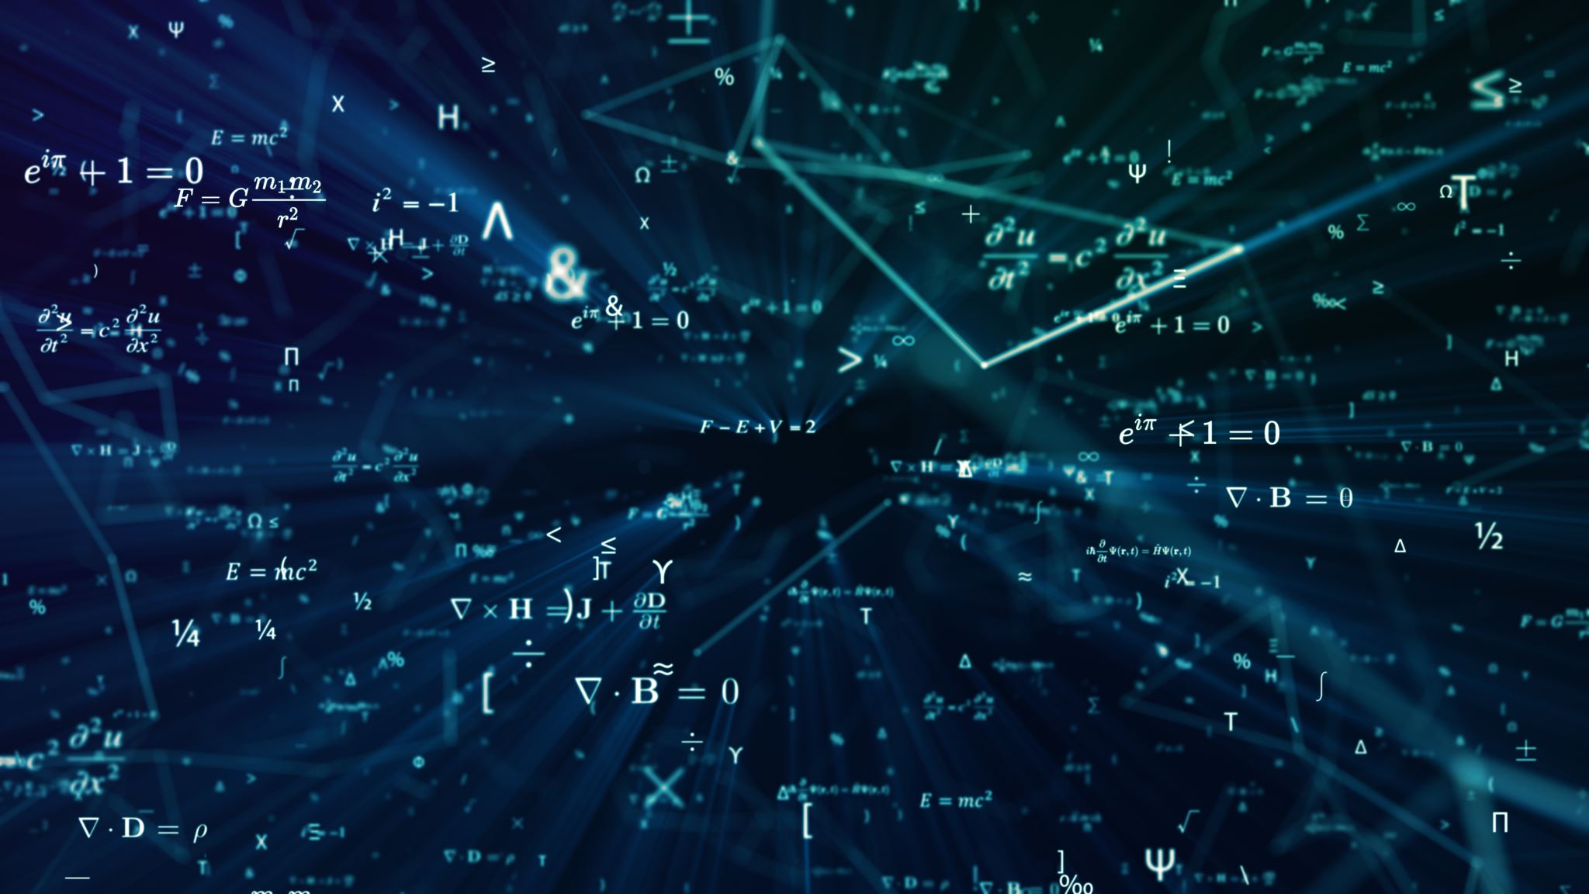
subsets = FindAllSubsets(unique_elements)
print("All subsets:")
for i in subsets:
print(i)
print("The number of subsets = {}".format(len(subsets)))

Slide 16

Requirements

Slide 17

Write a code that finds all subsets of a given set of n elements. The code should ask the user to enter the n and the elements.

Slide 18

Execution

Slide 19
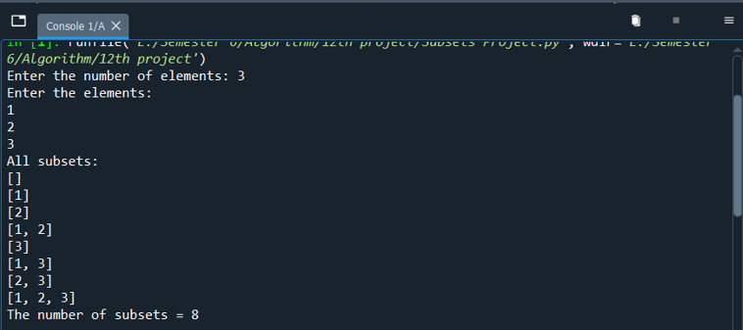
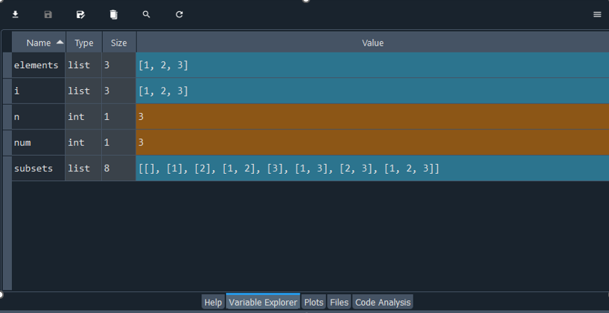

Slide 20


Thank you

